Slide 1
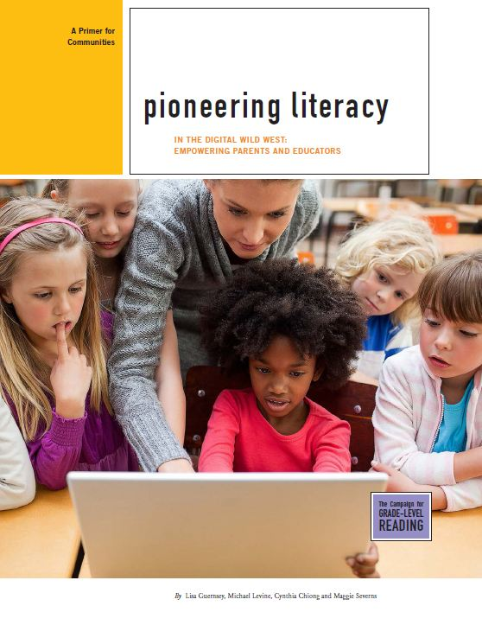


Pioneering Literacy in the Digital Wild West
Empowering Parents and Educators
Joan Ganz Cooney Center &
New America Foundation
The Campaign for Grade-Level Reading
December 2012
Notes:
1
Earlier this year, we proposed to help the GLR Campaign by taking stock of how, where and if technology could make an impact on reading achievement in young children. This is a joint project of the Joan Ganz Cooney Center and the New America Foundation, and it speaks to an interest in exploring connections between literacy and technology that we have had for a long time.

Slide 2
The Campaign for Grade-Level Reading
The Campaign for Grade-Level Reading focuses on the most important predictor of school success and high school graduation—grade-level reading by the end of third grade.
Schools cannot succeed alone. The academic success of children from low-income families will require engaged communities mobilized to remove barriers, expand opportunities, and assist parents to serve as full partners in the success of their children.
Notes:
Emphasize the network

Slide 3
Can well-deployed technology help equip low-income parents and teachers with the tools and information they need to promote children’s reading? Also:
Key research questions
Can technology help connect parents to literacy initiatives?
How is technology used by teachers in early education?
What helps bridge informal and formal uses?
3
Notes:
Our main research question is this. Corollary questions included these.

Slide 4
Why examine the potential of today’s technology?
Depending on content and context, digital media have been shown to spark learning.
Technology is now a big part of children’s lives.
But access and use varies…
…which may exacerbate already wide achievement gaps.
4
Notes:
These are the big reasons that motivated us to embark on this project.
4

Slide 5
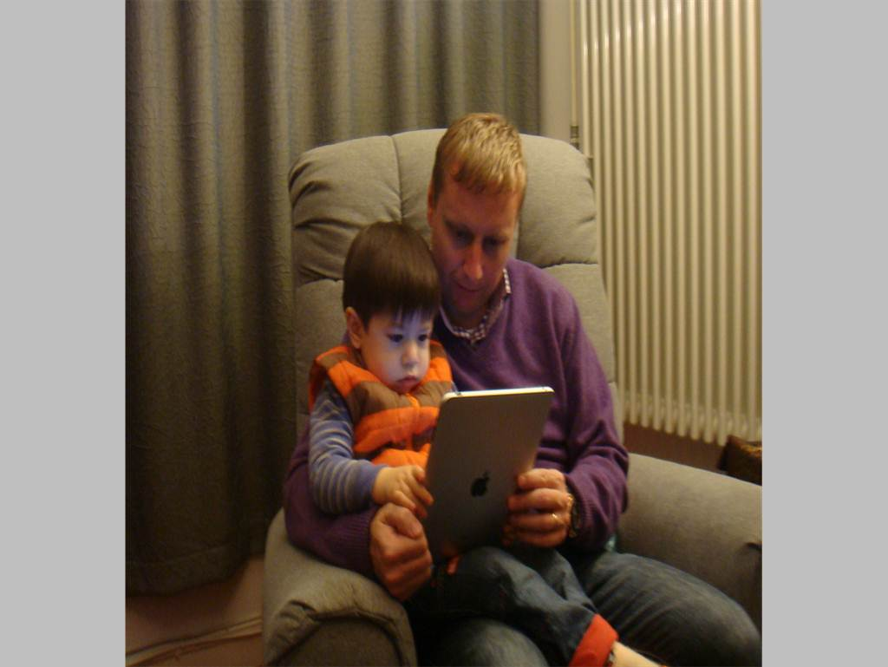
In search of “learning together” moments
Flickr.com/Elaine and Scott van der Chijs courtesy Creative Commons license
Notes:
Let’s talk about that first point for a moment – the idea that depending on content and context, digital media have been shown to spark learning. We recognize that many people – especially those of us who work in early childhood – do not immediately thinking of digital or electronic media as having a positive impact on learning. Instead the image in our heads is a nefarious television with children watching hour after hour, substituting for free play or hands-on activities. But digital media today can be something quite different. For example, in this picture, it looks a lot like a book, with father and son learning together.

Slide 6
4 Guiding Principles
Parents are crucial
To ignore technology is to allow gaps to widen
Skills + knowledge:
Reading requires both
Technology by itself
is not the answer
6
Notes:
6

Slide 7
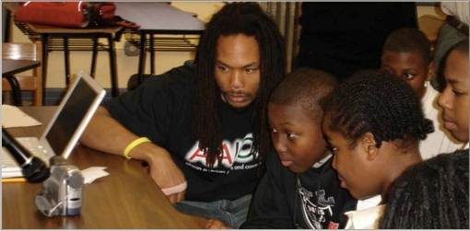
Joint engagement
Could educators and tech developers encourage families to watch, talk about and play with digital media together? What can be done to prompt more back-and-forth conversation — a cornerstone of children’s language development and later reading skills?
Photo by Brigid Barron
7
Notes:
We came to this research with a grounding in developmental science on how children learn language skills. Children’s language skills bloom when they have opportunities for contingent social interactions with parents and caregivers. In the research literature on electronic media this is known as Joint Media Engagement, a term coined by learning scientists at the LIFE Center, an NSF funded project. The Cooney Center recently hosted an event and published a paper – “the New Co-Viewing” -- on the promise of this approach.
7

Slide 8
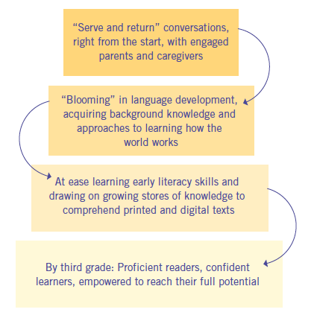
The Cascading Effects of Connected Parents and Educators Engaged with Children (0 – 8) Around Quality Media

Slide 9
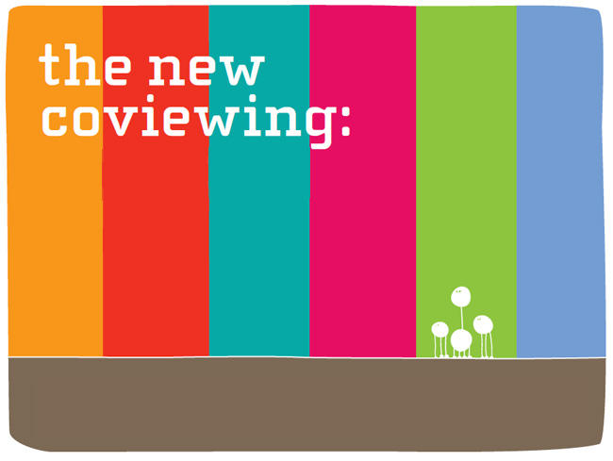
Research and design for learning together in a digital age
Lori Takeuchi
And Reed Stevens
Notes:
9

Slide 10

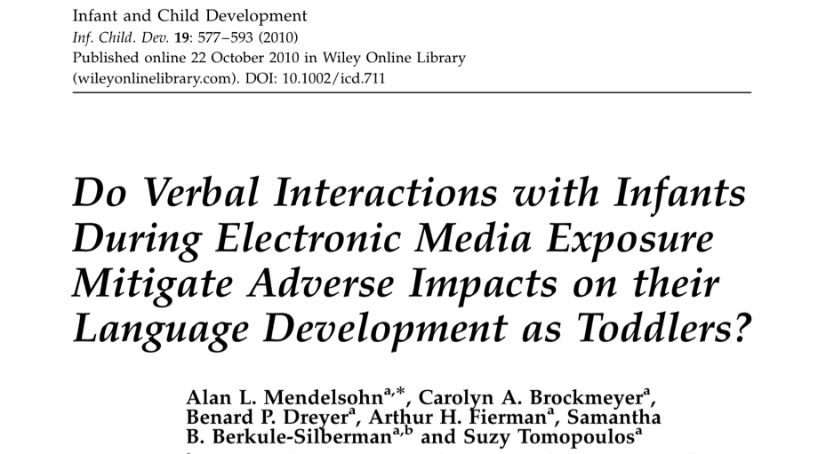
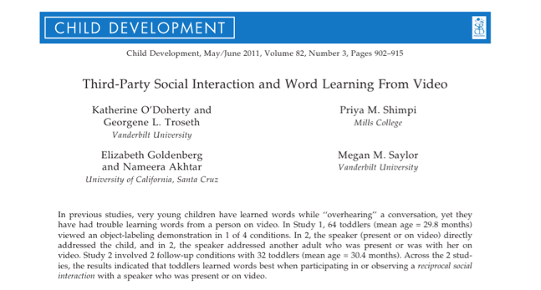
Studies show….
The value of
Reciprocal social interaction
Verbal interactions
Engagement and joint attention
Via media
10
Notes:
Research with preschoolers (click to animate) infants (click to animate) and toddlers (click to animate) – and research beyond just the three studies here -- has consistently shown the benefits of parents or teachers engaging in “reciprocal social interactions” spurred by video and interactive media. This isn’t new in the realm of TV research – 1990s research on the TV show Barney and Friends, for example, children who watched a video and talked with a teacher about the content learned more than children who only had teacher interaction and didn’t watch the video at all. But it is becoming apparent in research with interactive and digital media as well.
10

Slide 11
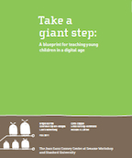
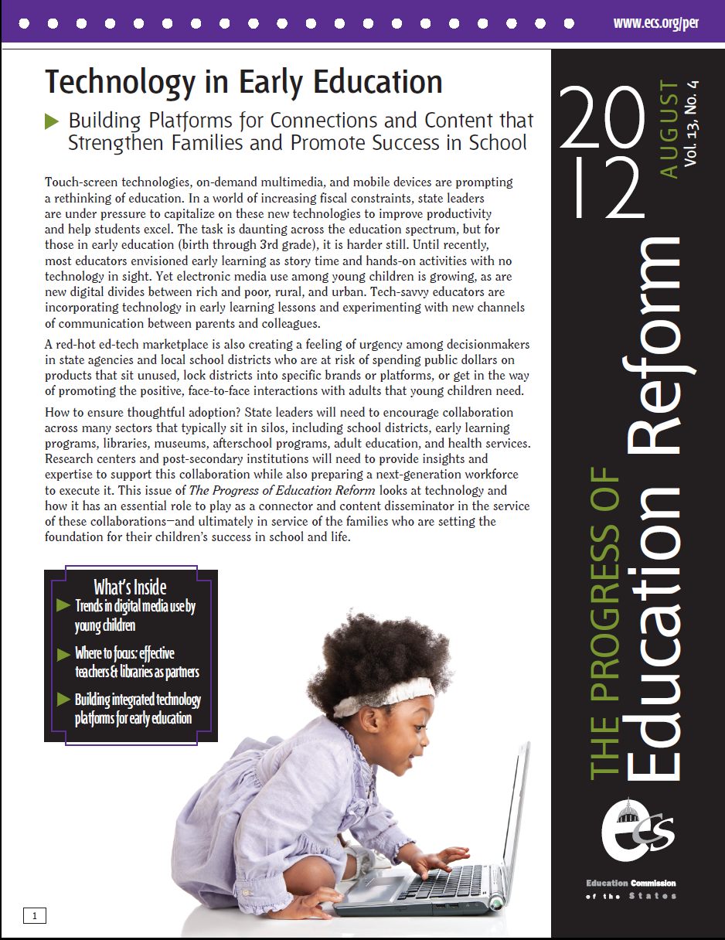
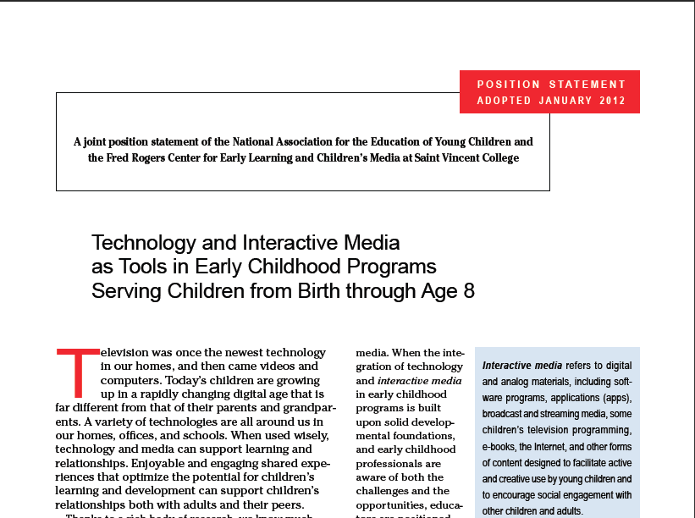
The field of early ed is recognizing technology’s emergence
Notes:
The potential inherent in appropriate uses of technology is not lost on today’s early childhood professionals. In January, the National Association for the Education of Young Children released a long-awaited statement on technology and interactive media as tools in early childhood programs. Here are two of the points made in that statement.

Slide 12
Digital media are part of preschoolers’ lives
SOURCE: Always Connected, JGCC, 2011 (2009 data).
Notes:
In this bar graph, you see that up to two thirds of preschool-aged children have played games on a console. At least half of minority children are playing mobile games before kindergarten.

Slide 13
Low-income families less likely to have latest tech or to use apps
Children from low-income households use apps and mobile devices less frequently than children from high-income households (Common Sense Media, 2011).
13
Notes:
Last year a new term was coined, the App Gap. Parents of children from high-income households have iPads and are buying apps for their kids. Low-income families, not surprisingly, are less likely to do so. [I should note, though, that smartphone usage among low-income young people is nearly as high as the national average.]
13

Slide 14

Neuman & Celano studied two libraries in Philadelphia serving two different socio-economic classes.
Witnessing disparities in how adults interact with children using technology
Finding: Vast differences in how adults interacted with children using computers and digital games, as well as books.
14
Notes:
Almost 1/3 of households still don’t have access to broadband. (ESA & NTIA, 2011), but there is a dearth of information on how low-income families gain access to technology, what kinds of technology and digital media they are more prone to use, what resources are most meaningful to them, and how families learn together (or not) via the media. A seminal study by Susan Neuman and Donna Celano, described in their new book, Giving Our Children a Fighting Chance, showed differences in the quality of interactions that parents and children engaged in while playing digital games or using ‘educational’ software in two libraries in Philadelphia.
14

Slide 15
A swelling marketplace
Over 80% of top selling paid apps in the Education Category target children; of those, 72% target preschool aged children (JGCC, 2012).
Source: 148apps.biz; About.com
15
Notes:
So that gives you a sense of the teeming technology scene for young children and their parents. Let’s turn for a moment to the marketplace, especially the app marketplace. It’s booming. Look at this growth in apps from mid 2008, when the iTunes store opened, to today. This goes to June 2012, and the more recent numbers from 148apps.biz show that there are now about 730,000 active apps available to buy or install. Games and education are the top two categories in the iTunes store. In the education category, children are a big target. Preschool children especially.
15

Slide 16


Feeling a little like the Wild West
TarynMarie on Flickr via Creative Commons license
Thomas Hawk and Thom Ross on Flickr via Creative Commons license
Notes:
What are those apps like? Who makes them? What qualifications do they have? Whose interest is at heart?
Who’s to say. It feels the Wild West.
16

Slide 17
Our scan of the landscape
A two-pronged approach
Products
Apps
E-books
Games
Websites
Programs
Supporting parents
Assisting teachers
17
Notes:
We Conducted a Scan of the Landscape: What Technologies are Available? We took a two-pronged approach: seeking out examples of products and interventions/programs.
Professional development models
Comprehensive curriculum packages
Projects funded through federal or state grants
17

Slide 18
Product Scan
April 2012
Notes:
18
So let’s get into what we have found.

Slide 19
Apps
Top 20 paid “educational literacy” apps in iTunes
Top 20 free “educational literacy” apps in iTunes
Top 20 paid “educational literacy” apps in Android
Top 20 free “educational literacy“ apps in Android
E-Books
Top 20 featured e-books for kids on iTunes*
Games
Reviewed “educational literacy” games on Common Sense Media for kids ages 2-8, released 2007-2012; n=17
Websites
Top 20 reviewed “educational literacy” websites on Common Sense Media; must include content for kids.
The data (April 2012)
19
Notes:
*No nook/kindle analyses yet.
19

Slide 20
The products had to target one or more of the following areas associated with literacy:
Print concepts
Letters and letter-sounds
Phonics with word recognition
Letter Writing
Sight Words
Spelling
Vocabulary
Comprehension
Understand and tell stories
Grammar
Definition of literacy-focused
Best Practices:
Fiscal Tools
20
Notes:
In our scan, we counted a product as “literacy focused” if it made a reference to one or more of these concepts or activities in the app description written by the developers. It’s important to note that caveat. We did not play every app ourselves. We looked at what the games *purported* to do for children.
20

Slide 21
We only looked at products targeting 0-8.
Target age groups
Early Elementary
Apps, Games, Websites
Preschool
Apps, E-books, Websites
0-2
21
Notes:
So far in our scan we have found not much targeting 0-2… mainly targeting preschool and early elem. E-books aim younger, games aim older, apps and websites aim for both.
21

Slide 22
Key finding: most of the popular apps target very basic literacy skills
22
Notes:
Note that 6 out of 8 of the android apps that were vocabulary were just flashcards.
Also, no apps targeted “print concepts” but it looked weird to have a blank in the front and it doesn’t fit.
22

Slide 23

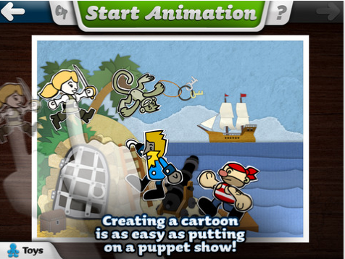
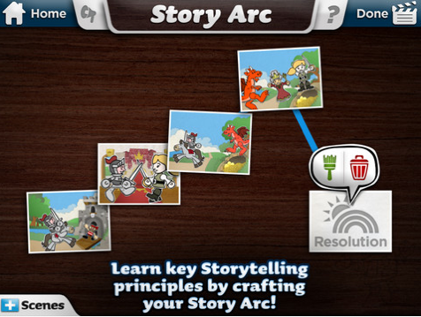
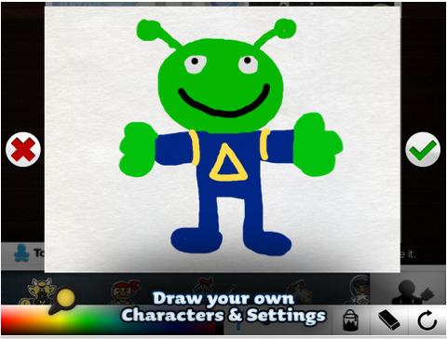
Only few apps went further.
Understand and tell stories
23
Notes:
From Cynthia: Here is Toontastic – I think you all have seen this one – helps you build a story – learn about elements of story telling.
23

Slide 24

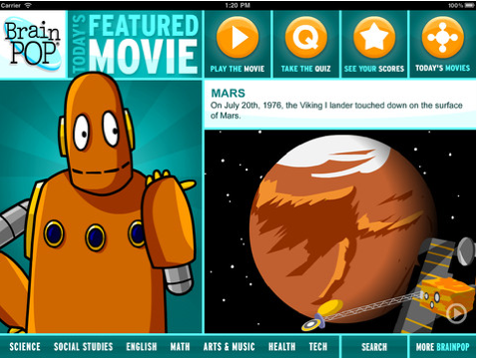
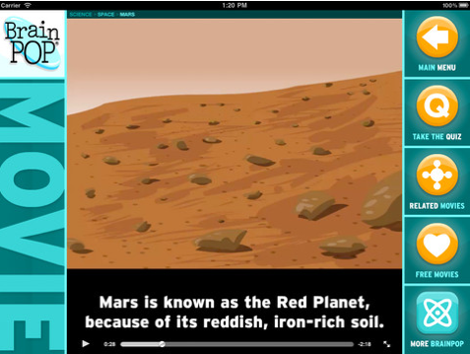
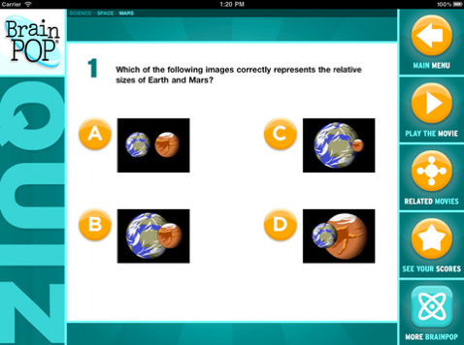
And very few help with building background knowledge. Here’s one exception.
Comprehension
Notes:
From Cynthia: Brain pop - one of the FEW comprehension apps out there. Watch a video – videos cover many different areas (science, literature, etc.) and then asks comp questions at the end. I think this touches on the “background knowledge” point with the National Geographic website.

Slide 25
Websites target larger range of literacy skills
** 2 websites were excluded because we did not have a subscription.
45% of web sites we scanned target more than just literacy
25
Notes:
We found that websites offered materials that targeted a broader range of skills and included more resources for helping children build vocabulary and background knowledge to aid in comprehension.
25

Slide 26
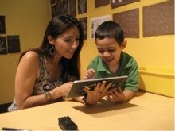
Extraneous “hot spots” can impede the traditional reading process for parents and children and may affect children’s comprehension. (JGCC, 2012).
Parents are reading e-books with their young children, based on survey of 1200 middle class parents with child age 2 to 6 (JGCC, 2012).
E-books
26
Photo by JGCC Research Team
Notes:
Source:
Joan Ganz Cooney Center (2012). E-book Quickstudy: Parent Survey. Sample – 1200 parents with a child age 2-6.
26

Slide 27
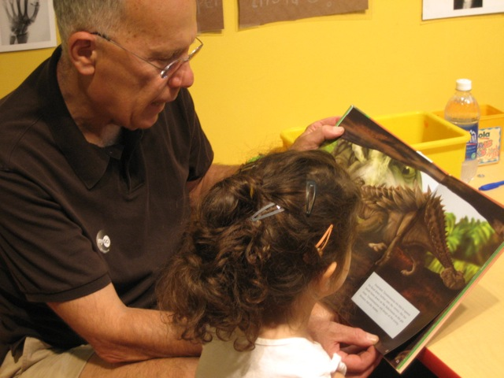
… but they are not necessarily features to enhance literacy learning.
Almost all include narration, but only half highlight the text.
Most include interactive features that are not literacy oriented.
E-books in the app store offer many features….
Photo by JGCC Research Team
27
Notes:
27

Slide 28
Program Scan April 2012 – November 2012
28
Notes:
28

Slide 29












Interviews and research
Notes:
Our teams at New America and the Cooney Center have been interviewing literacy program leaders, librarians, teachers and researchers around the country to glean how they use technology and if they have words of wisdom for how it should be employed to help young children learn to read. Here are logos for many but not all of the interviewees we’ve talked to so far.

Slide 30
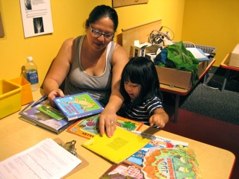
Parents prefer participating in activities with their kids that involve older media – watching TV (89%), reading books, (79%), playing board games (73%) (JGCC, 2011).
Parents think that computer-based activities are most valuable for young children’s learning (JGCC, 2011).
Is there enough focus on parents?
Photo by JGCC Research Team
On the power of video: “Providing that visual, seeing and hearing, and having parents see parents who they can relate to… that can make for some of those ‘aha’ moments where change can begin to happen.”
-- Kathleen Strader, Zero to Three
30
Notes:
So far we haven’t come across as many programs that reach parents, or that attempt to reach parents, in a comprehensive way that is part of a literacy intervention. However, several people we’ve interviewed have talked about the potential of technology – either as a way to build personal connections to parents or between parents and as a way to “show not tell” when providing models of language-rich engagement with their kids.
30

Slide 31
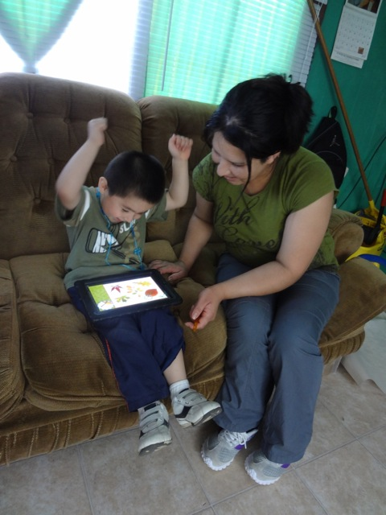
Comienza en Casa
Migrant family literacy in Maine
iPads + offline ‘play-based’ language activities
Ele, by the Fred Rogers Center
Early learning environment for home-based caregivers, including parents
“Library and playroom”
Create “playlists” of activities
The Baby Elmo Program
Modeling positive parenting via Sesame Beginnings videos
For incarcerated fathers
Findings: Pioneers in using tech to support parents
Bonnie Blagojevic for Comienza en Casa in Maine
31
Notes:
Through these interviews, we’ve heard about interventions and programs that are using digital media or, in some cases, more traditional electronic media, such as DVDs. In many cases, the programs are aimed at helping teachers and caregivers of young children. Here are three.
31

Slide 32

Wonderopolis
National Center for Family Literacy
“Wonder of the Day” for language/cognitive development
Storytimes Online
Picture-book-of-the-day via free e-subscription & literacy activities daily on public library websites
Idaho (recent winner of IMLS grant), Virginia, South Carolina
Pioneering Programs supporting parents
32
Notes:
2007 to 2011
FARMS – 34.8 to 17.5
Non-FARMS – 29.8 to 9.8
32

Slide 33
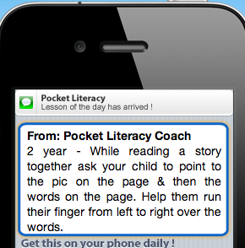
Pocket Literacy via Ounce of Prevention Fund
Sends daily texts to parents’ mobile phones with ideas for literacy activities
Head Start parents will evaluate the service in 2013
Mind in the Making Learning Communities
Parents, educators and health professionals gather to watch video clips from baby experiments and discuss Ellen Galinsky’s Mind in the Making
35 organizations in 22 states
Pioneering Programs Supporting Parents
33
Notes:
33

Slide 34

Children’s Literacy Initiative’s Compass
Free video library of strategies for teachers (how to engage children in books, dialogic reading techniques). Dept. of Ed funded.
Success for All embedded video
Augmenting reading lessons with video clips and computer-assisted tutoring.
Targeted Reading Intervention
Webcam coaching of reading teachers. University of North Carolina.
Findings: Pioneers in using tech to assist teachers
34
Notes:
Through these interviews, we’ve heard about interventions and programs that are using digital media or, in some cases, more traditional electronic media, such as DVDs. In many cases, the programs are aimed at helping teachers and caregivers of young children. Here are three.
34

Slide 35

Pioneering Programs Assisting Teachers
Innovations for Learning
Computer-based reading programs assist teachers and enable volunteer tutors who call students in the classroom via a Skype-like system as children read online books
iRead
Students use iPods to record themselves reading books; teachers listen to audio files and personalize instruction according to what they hear.
Ready to Learn “transmedia” products
Creating and evaluating suites of learning products for parents and teachers across various platforms, including TV, Internet, and tablets.
35
Notes:
Through these interviews, we’ve heard about interventions and programs that are using digital media or, in some cases, more traditional electronic media, such as DVDs. In many cases, the programs are aimed at helping teachers and caregivers of young children. Here are three.
35

Slide 36
Future mapping: Four approaches to consider
Promoting personal connection
Reinforcing basic skills
Building background knowledge
Improving the workforce
Social networking
App games that test phonics knowledge
Video field trips
Professional dev hubs / online courses
Texting via mobile device
Flashcards for sight words
Children’s literature available as e-books
Better, on-demand access to curricular materials
Notes:
In our interviews and analyses of the marketplace, we’re seeing some trends. Here are four approaches to using technology that are either apparent or mentioned as being desirable.

Slide 37
Conduct community audits. Assess disparities in access and capacity to deploy technology for literacy outreach.
Create public engagement initiatives on the need for critical thinking about media.
Create a place in every community where parents and educators can experiment together with online and offline media as a springboard for children’s literacy.
Support sound research on how both technology content and contexts are affecting reading development.
Create partnerships for innovation. Stimulate collaboration among tech industry, educators, parents and community institutions such as schools, libraries and universities.
5 Recommendations:
From the Wild West to Pioneering “Literate Communities”
37
Notes:
37

Slide 38
Contact us
joanganzcooneycenter.org
Facebook.com/cooneycenter
twitter.com/cooneycenter
earlyed.newamerica.net
twitter.com/NewAmericaED
Notes:
38

